Slide 1



Slide 2
General Tips - Windows

Slide 3
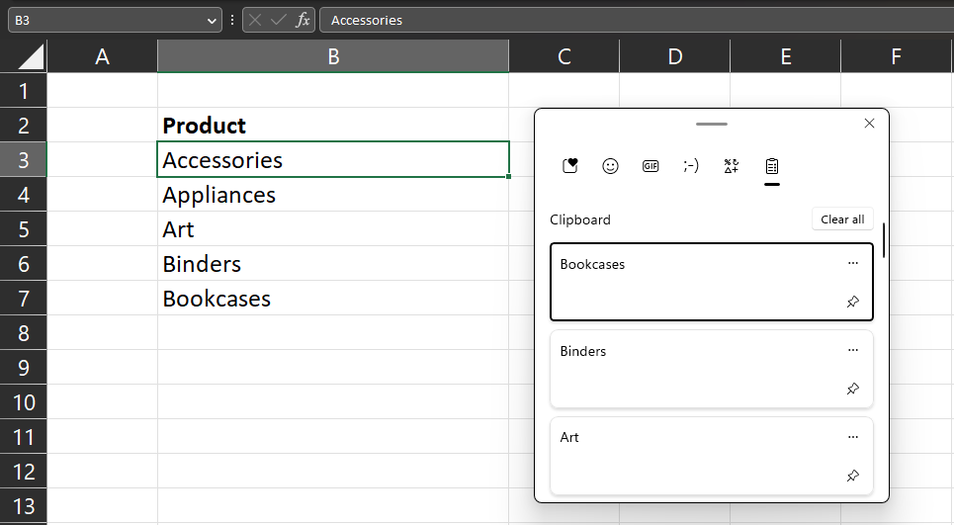


Copy and Paste Multiple values
See a clipboard with all
recently copied values
Works across applications

Slide 4
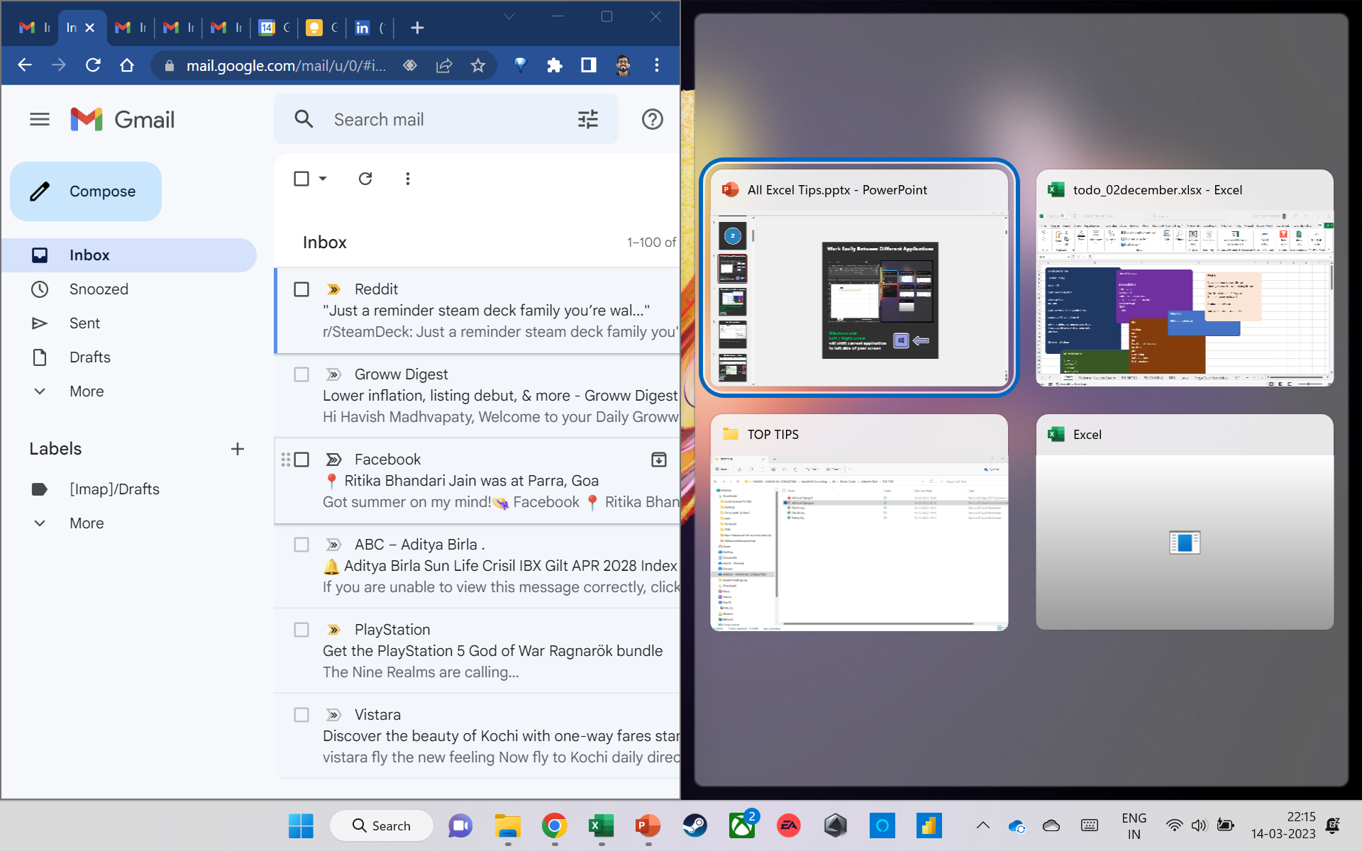

Work Easily Between Different Applications
Windows and
Left / Right arrow
will shift current application to left side of your screen

Slide 5
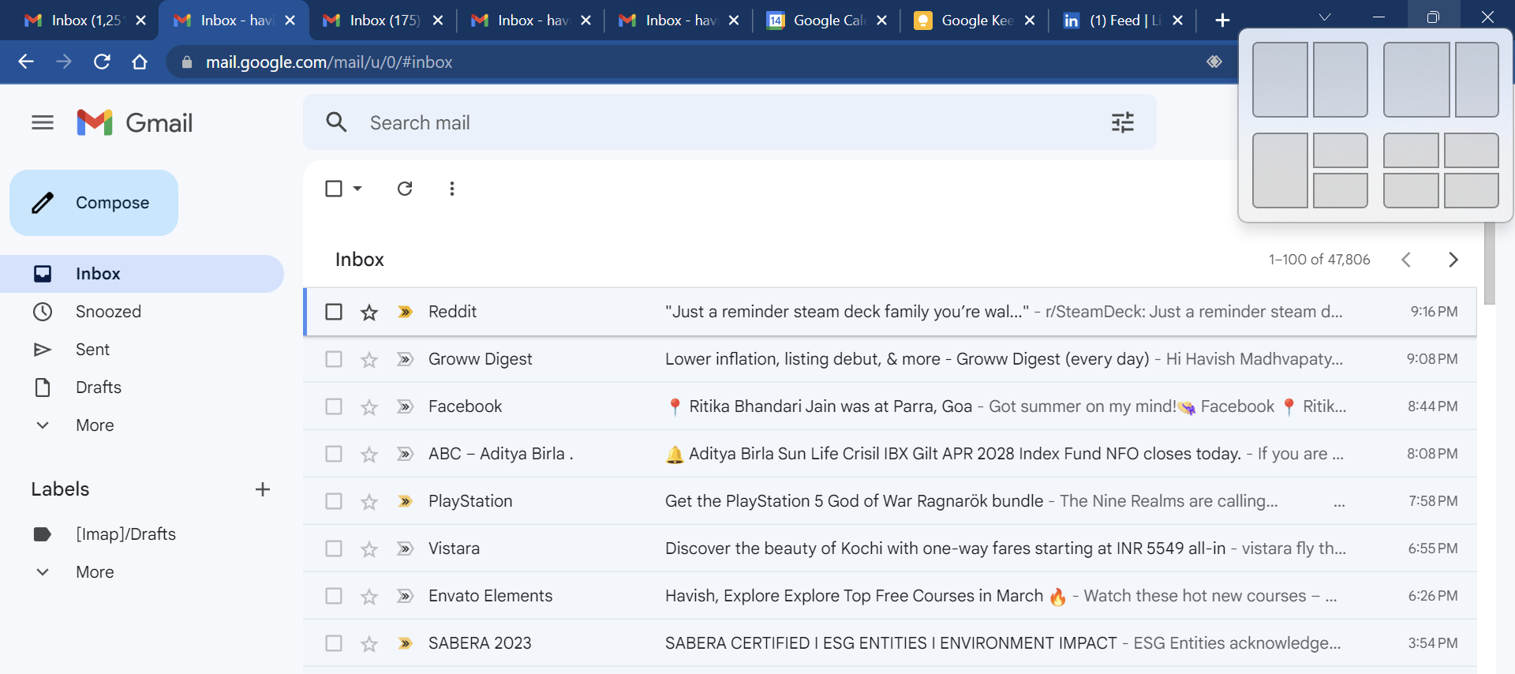
Work Easily Between Different Applications
Hover mouse on the
resize button to see different options

Slide 6
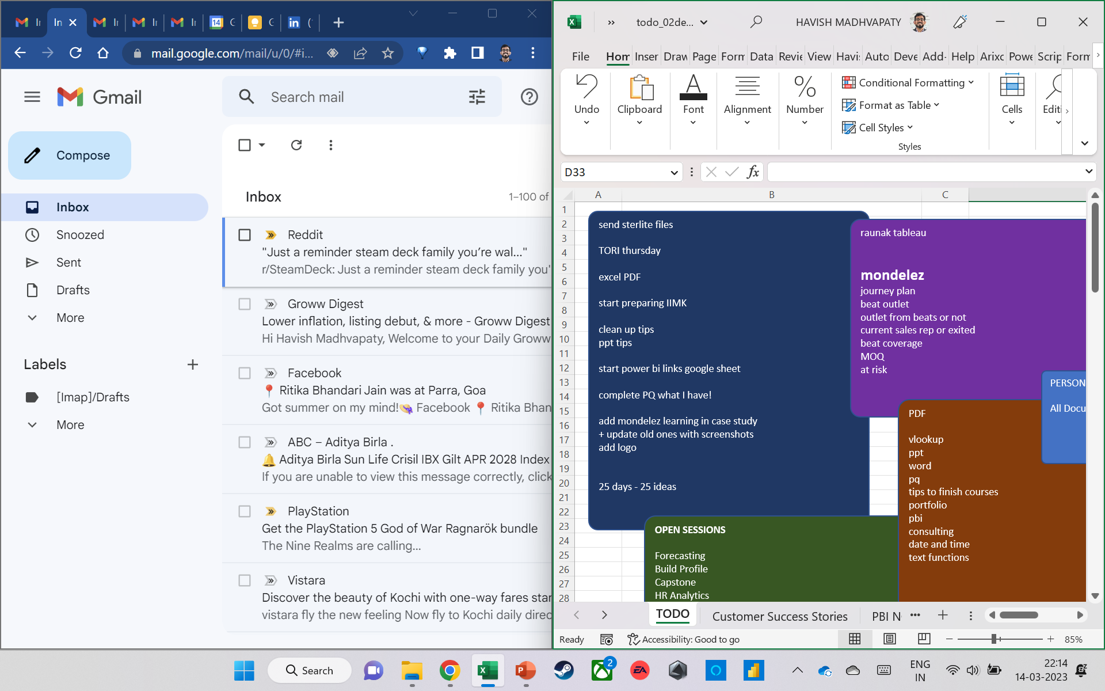
Work Easily Between Different Applications
Now BOTH applications are visible!
Makes it MUCH simpler to
multitask
copy data
reconcile data

Slide 7
General Tips - Excel

Slide 8
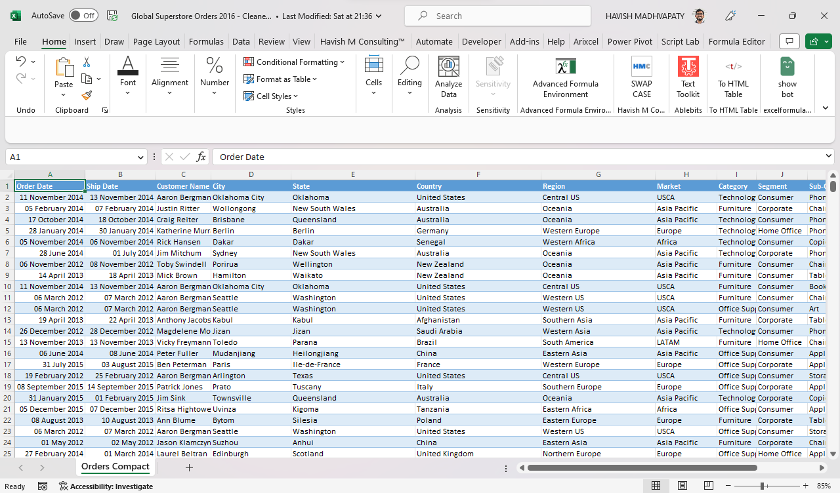
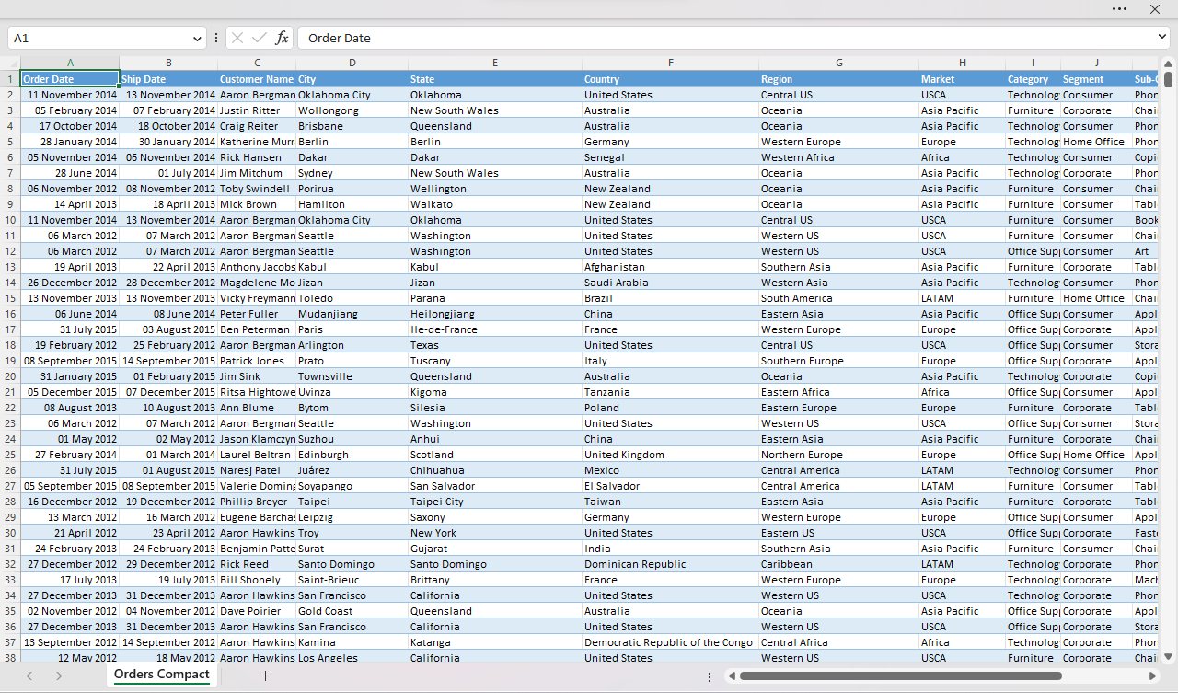



Hide / Unhide the Ribbon to
Increase Real Estate
Ctrl + Shift + F1
Toggles the ribbon – gives more real estate on the worksheet

Slide 9
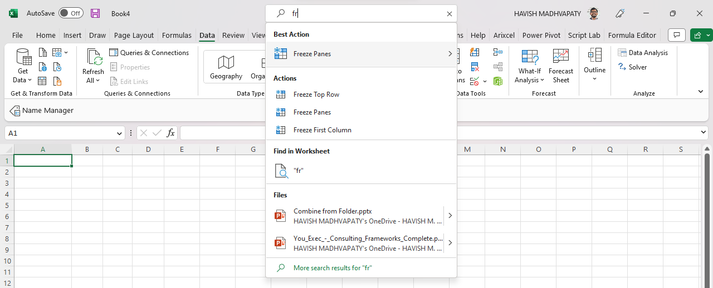


Search For Any Command Quickly
Use Alt + Q to search for commands

Slide 10
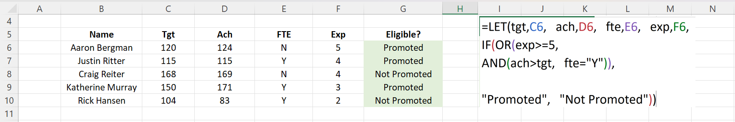

Take Screenshots To Make It Easier To
Read The Worksheet
While presenting your spreadsheet
screenshots make it easier for other to read
TIP
Use Windows + Shift + S to take screenshots

Slide 11
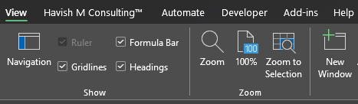
Check Multiple Sheets Concurrently
Want to see multiple sheets at the same time?
View > New Window opens a second copy

Slide 12
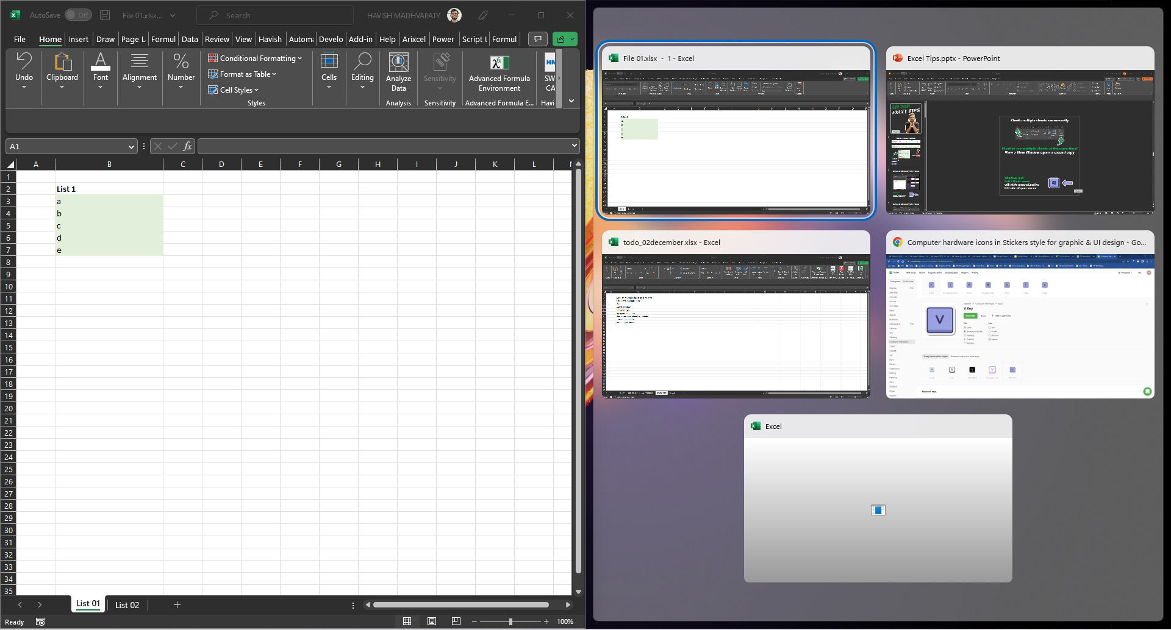
Check Multiple Sheets Concurrently
Windows and
Left / Right arrow
will shift current Excel to left side of your screen

Slide 13
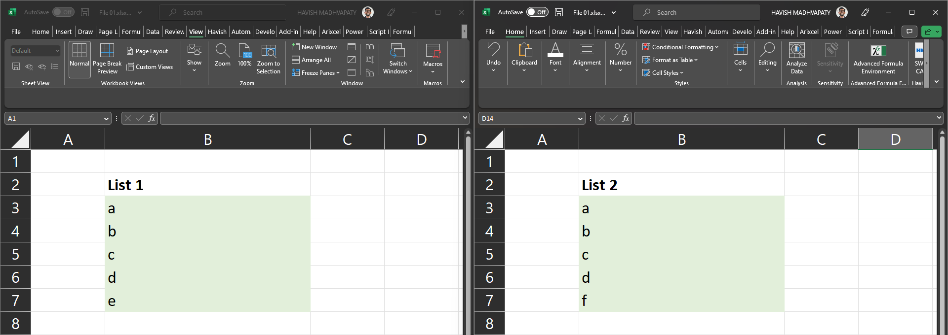
Check Multiple Sheets Concurrently
Now BOTH sheets are visible!
Makes it MUCH simpler to
copy data
reconcile data
write formulas

Slide 14
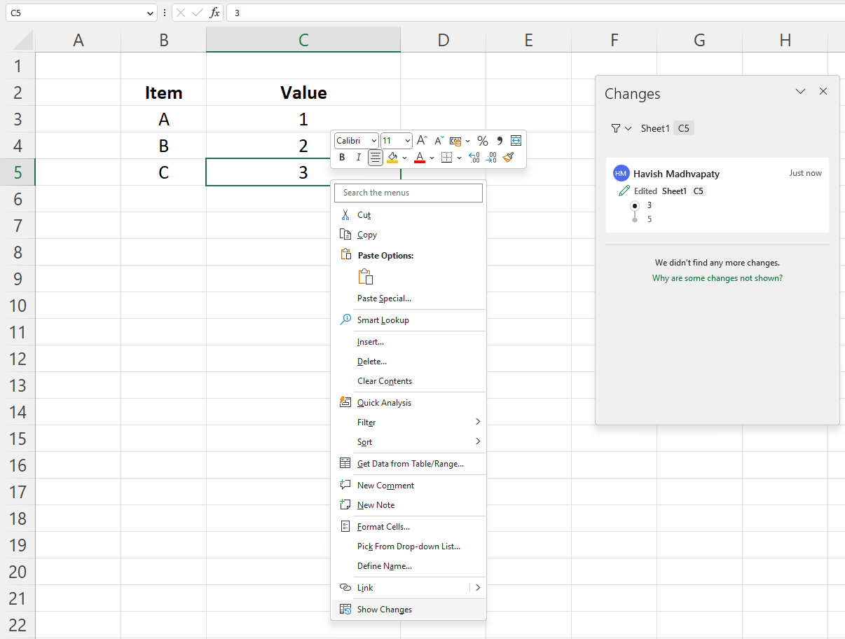
Show Changes To Turn Back Time

Slide 15
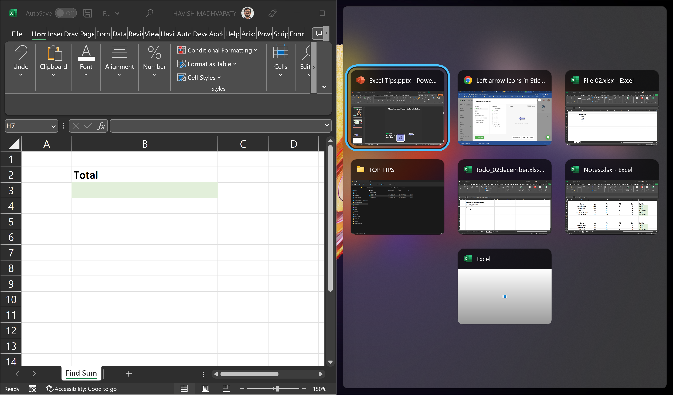
Work Easily Between Workbooks
Windows and
Left / Right arrow
will shift current Excel to left side of your screen

Slide 16
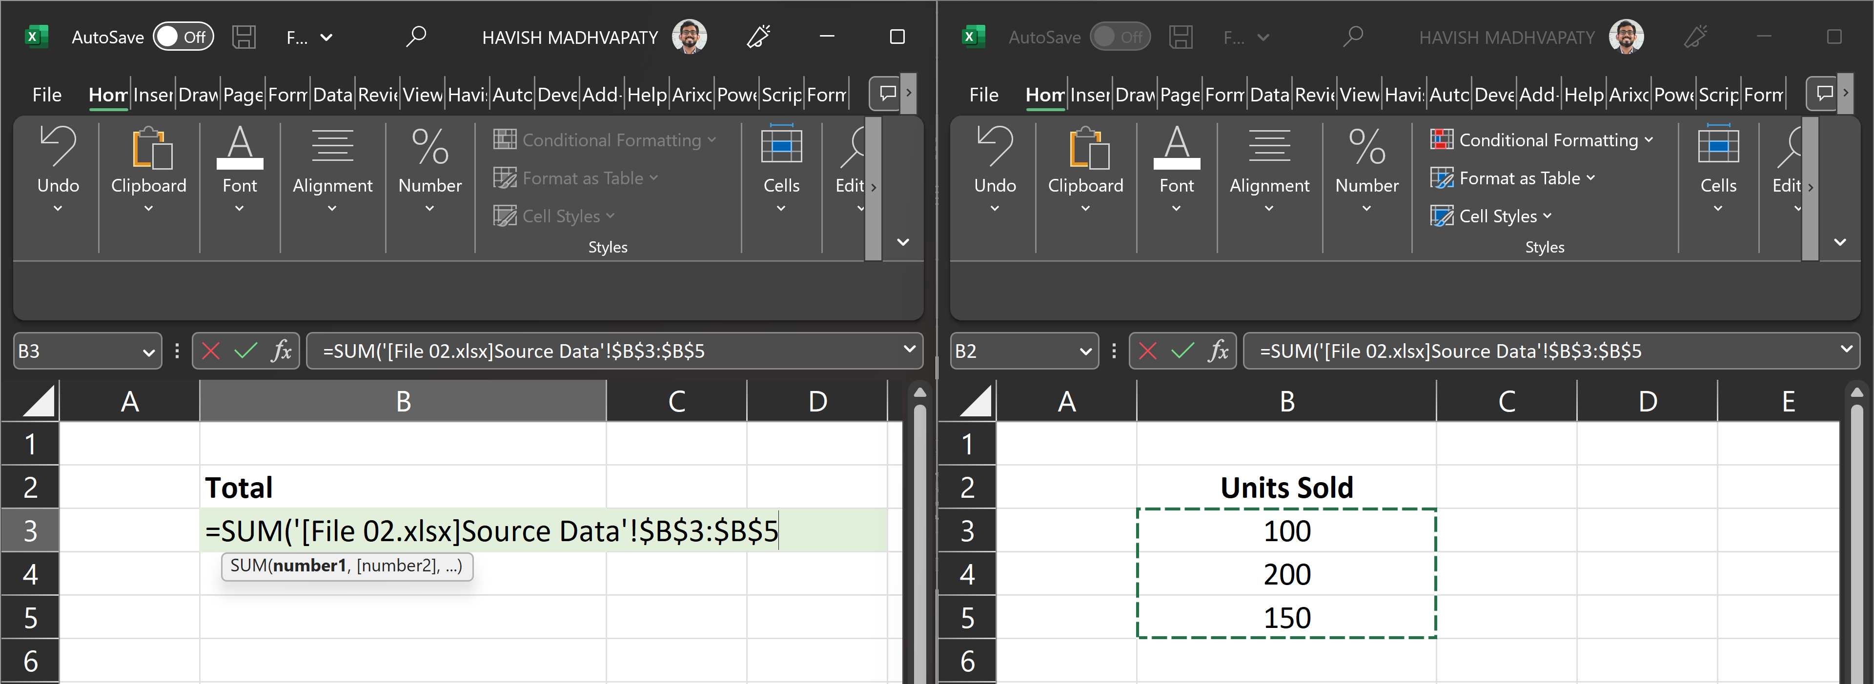
Work Easily Between Workbooks
Now BOTH Excel files are visible!
Makes it MUCH simpler to
copy data
reconcile data
write formulas

Slide 17
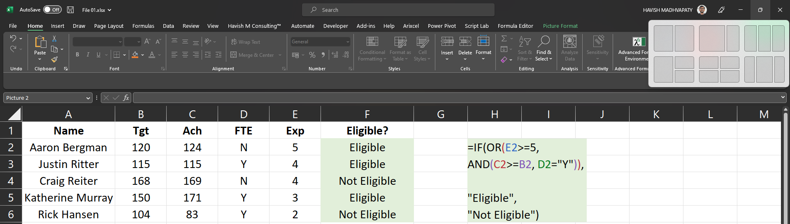
Work Easily Between Workbooks
Can also use the Screen resize Option on Windows 11

Slide 18
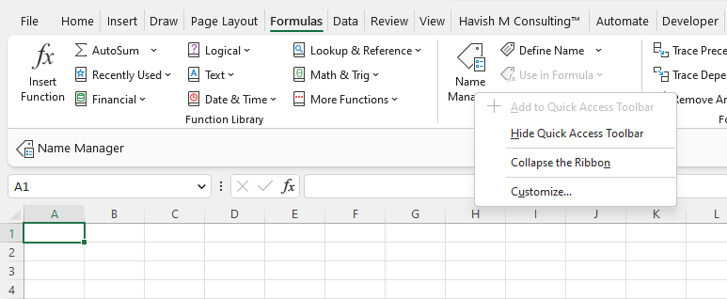

Use Quick Access Toolbar (QAT) For Most Used Commands
Right click on any command > Add to Quick Access Toolbar
Use for your most used commands
Can also access with Alt + [number]

Slide 19
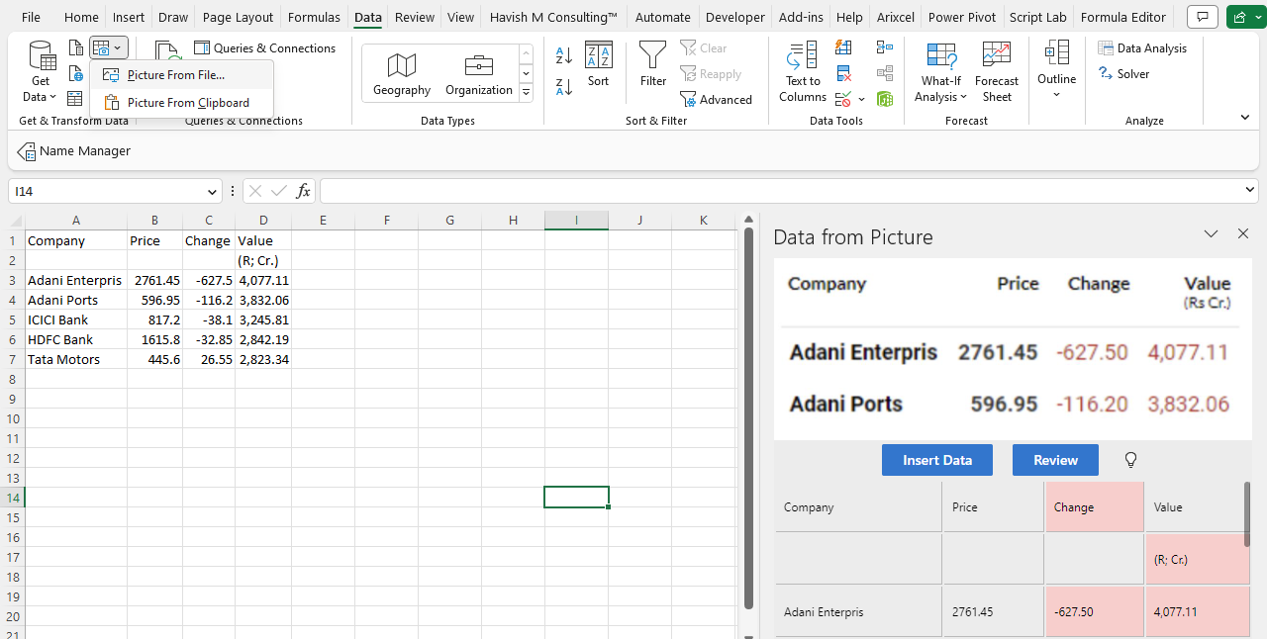
Copy Data From Picture
Data > Picture From File / Clipboard

Slide 20
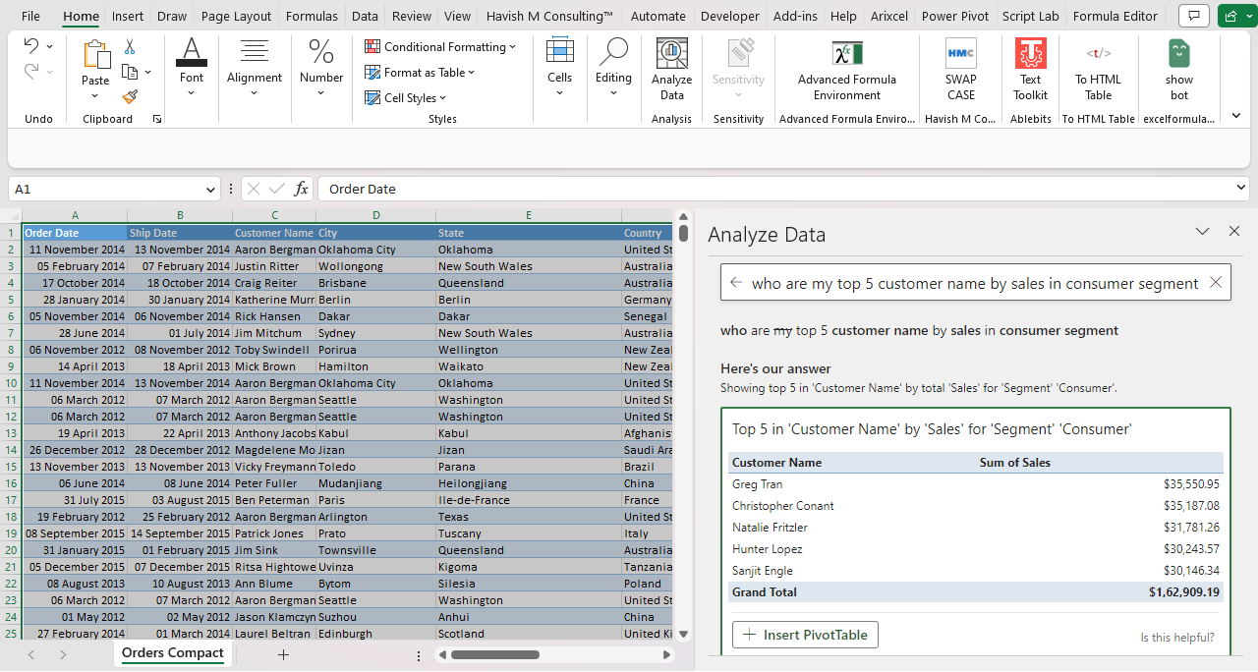
Use AI To Ask Questions
Use Home > Analyze Data to ask questions
Natural language questions – no need to learn
any code / syntax
Can create Pivot Tables / Tables directly

Slide 21
Better Formulas

Slide 22
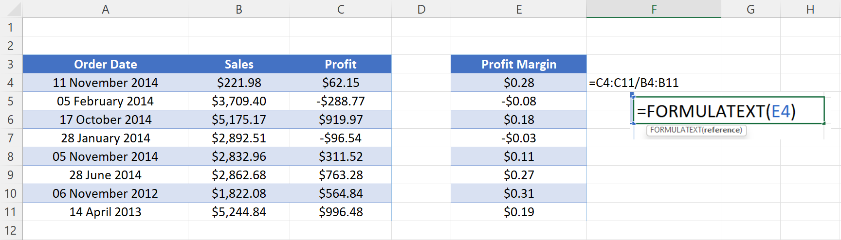
Use FORMULATEXT To See Formula
Next To The Cell
Use FORMULATEXT
to see formula in a cell

Slide 23
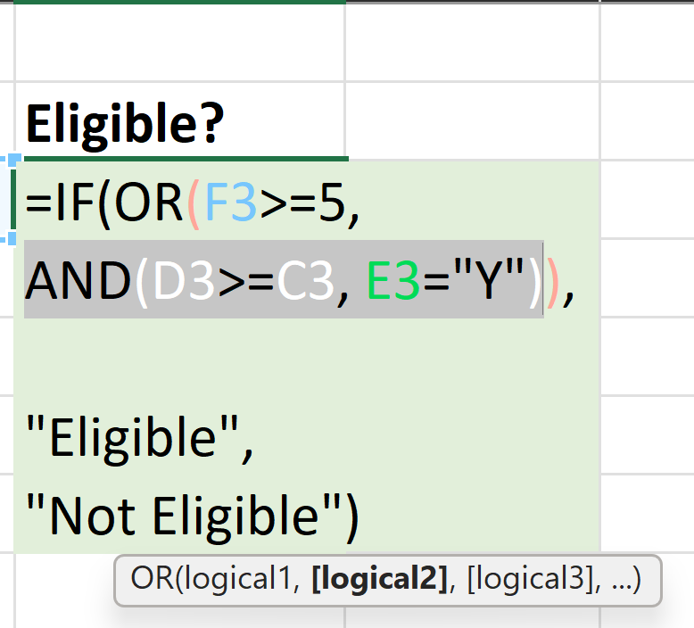
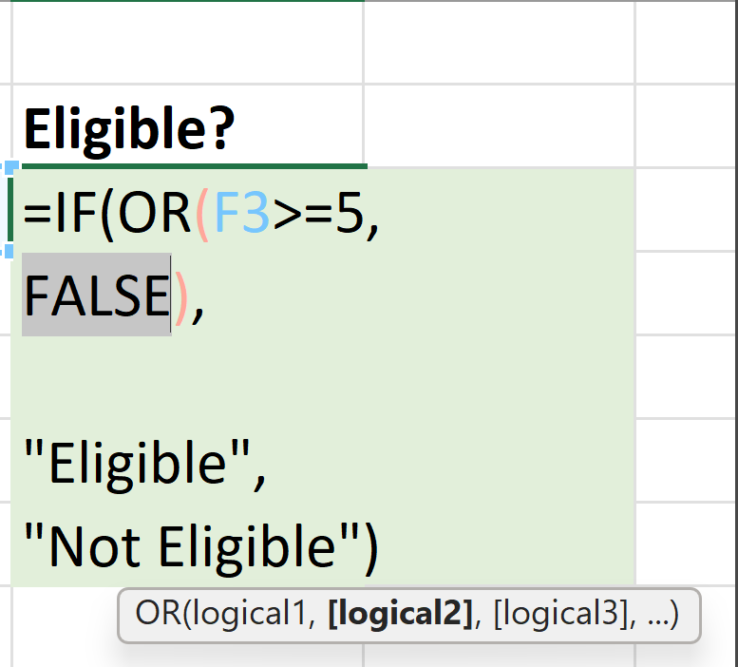

Check Result Of Intermediate Steps
Press F9
to see the intermediary result of the selected part of the formula Helps immensely to write and debug complex formulas

Slide 24
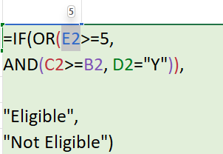
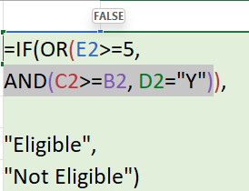
Check Result Of Intermediate Steps
Can also be seen when you hover over the cell / part of the formula

Slide 25
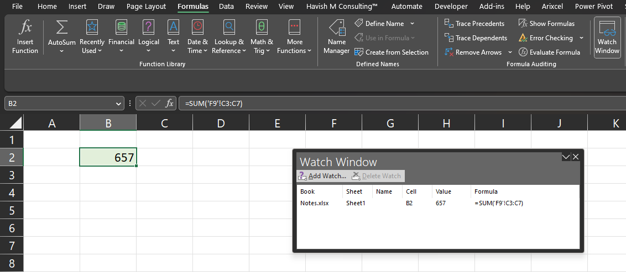
Use Watch Window To Track Formulas
Formulas > Watch Window
allows you to keep a track of formulas
Watch Window allows you to watch cells as they change even when you are on a different sheet!

Slide 26
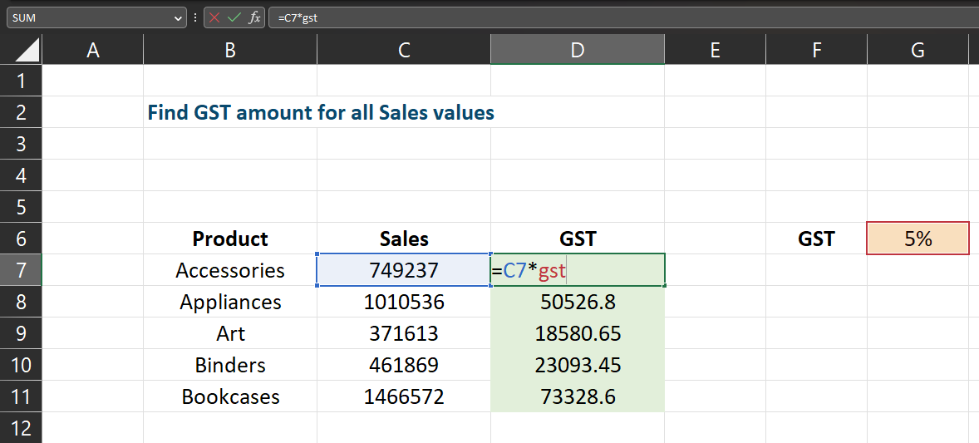

Named Ranges Make Selecting Ranges Easier
Providing names to cells / ranges
makes formulas more descriptive and easier to write

Slide 27
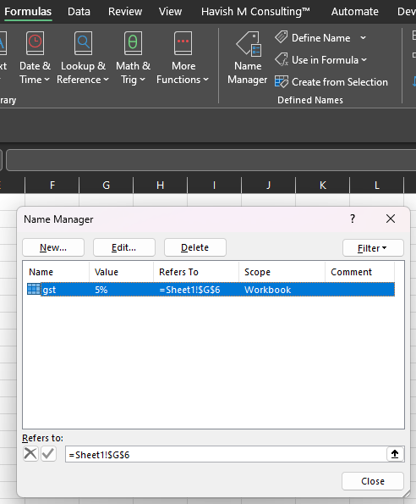
Named Ranges make selecting ranges easier
Formulas > Name Manager [Ctrl + F3]
Allows you to see a list of all named ranges in
one convenient place

Slide 28
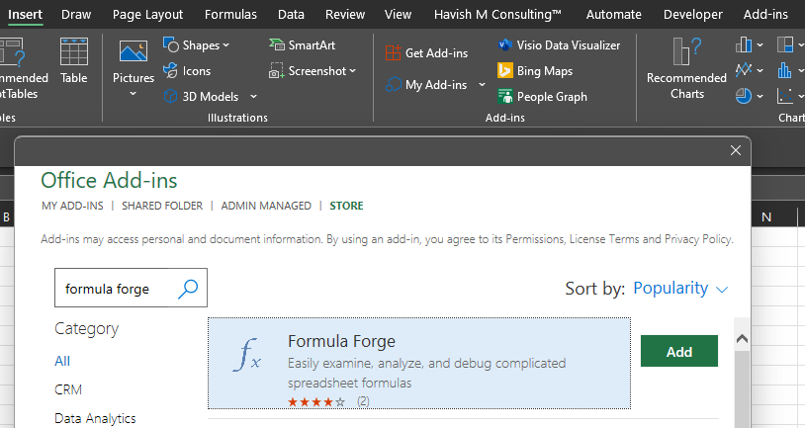
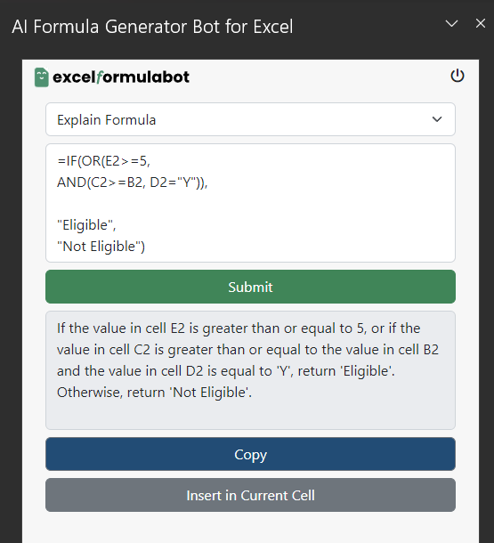
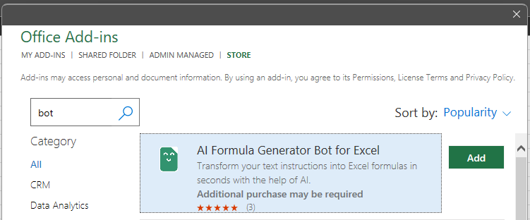
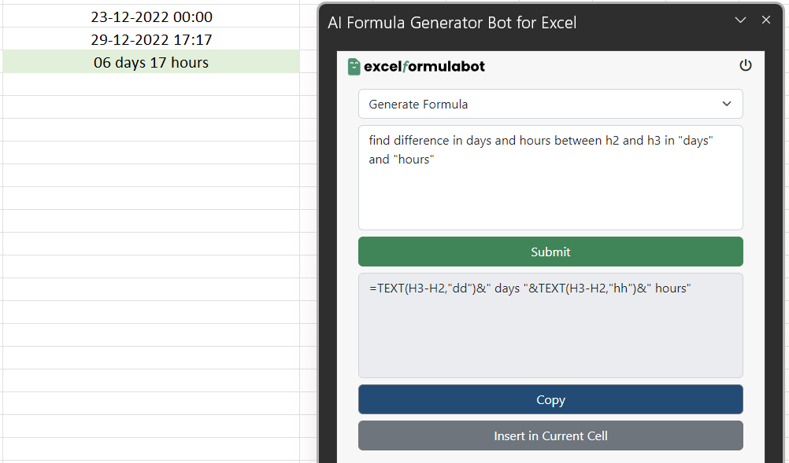
Write Formulas With AI
It explains your formula
in a simple, comprehensible manner
It can also generate your
formula as per the description
Insert > Get Add-ins > AI Formula Generator Bot for Excel

Slide 29
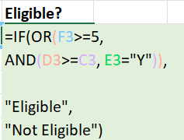


Make Formulas More Readable
DO NOT
Write Formulas
in 1 Line
DO Break Formulas by pressing

Slide 30
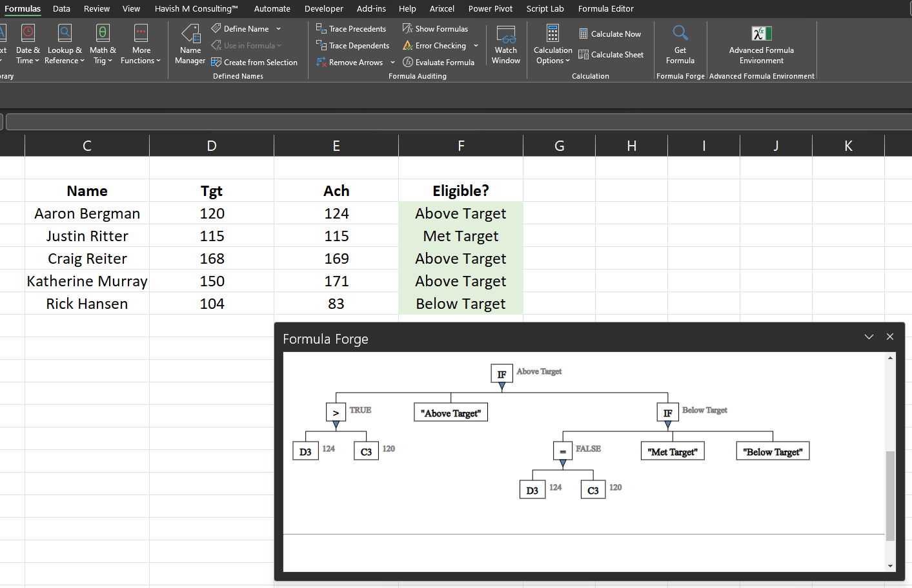
Check Tree View of Formula
Insert > Get Add-ins > Formula Forge
See a tree view of the formula to understand the formula step-by-step

Slide 31
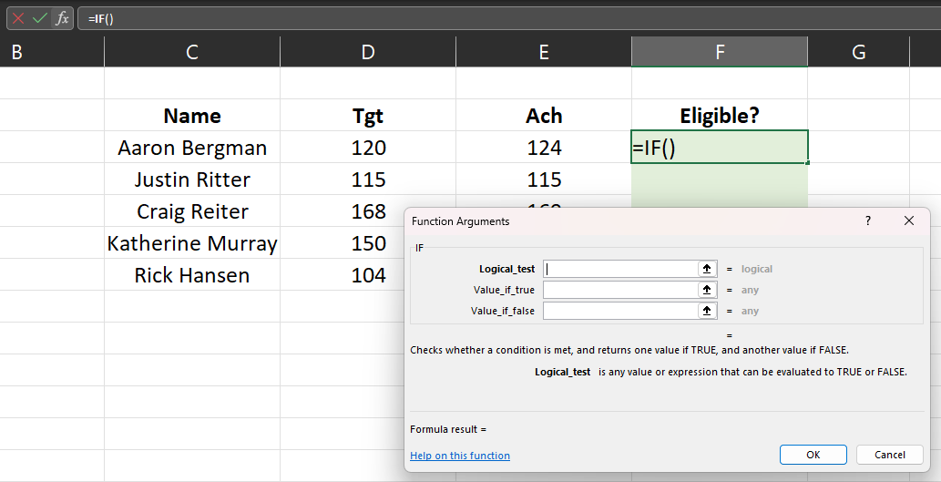
Use Insert Function Box
Use Insert Function box
Function Arguments makes writing functions like VLOOKUP much easier, especially when working across worksheets

Slide 32
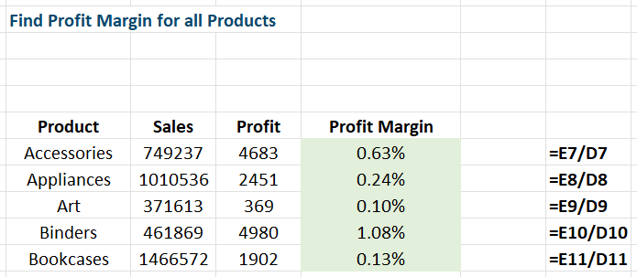
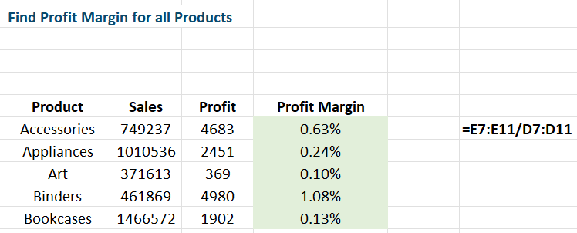
Use Dynamic Arrays To Get Multiple Results From a Single Formula
DO NOT
Write Multiple Formulas
DO
Write a single formula that spills into cells

Slide 33
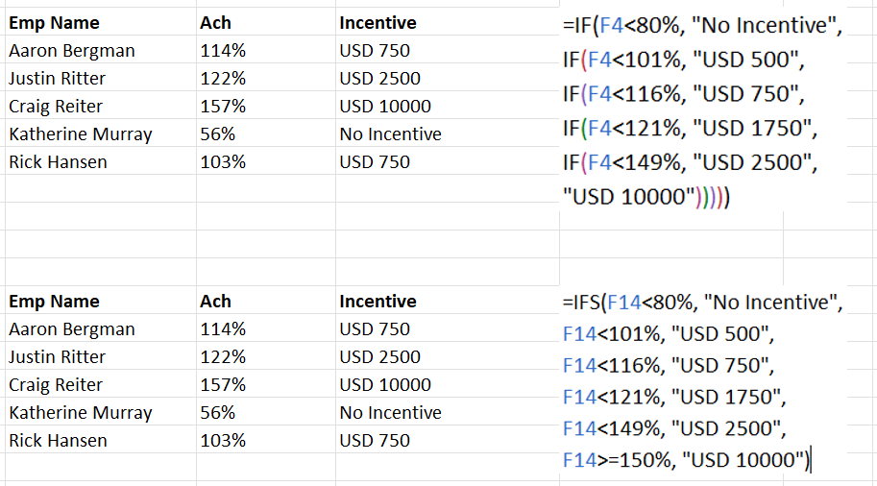
Use IFS Better Than Nested IF
Easier to write in case of multiple conditions
as only 1 single function is required

Slide 34
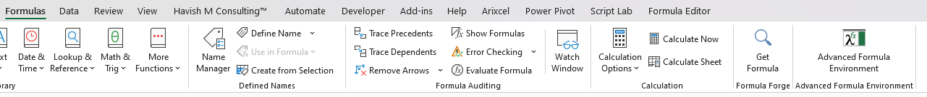
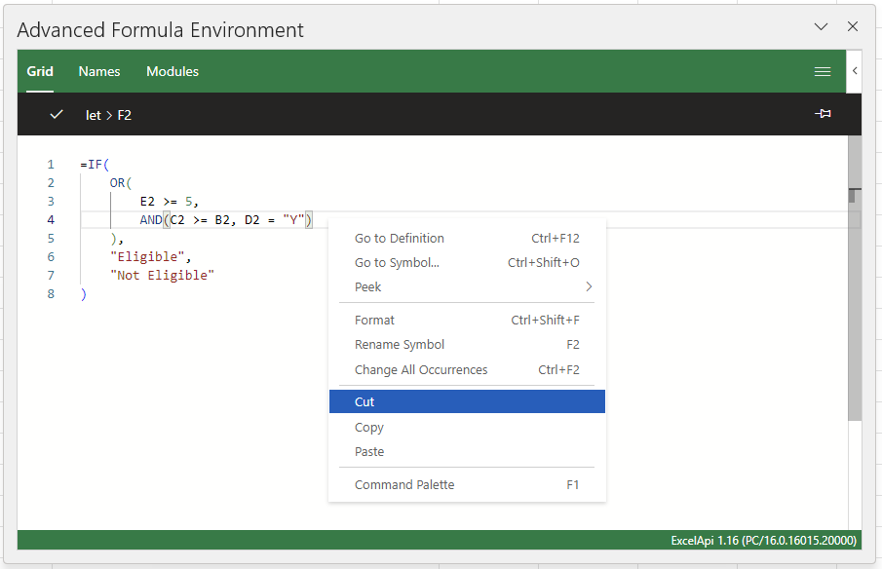
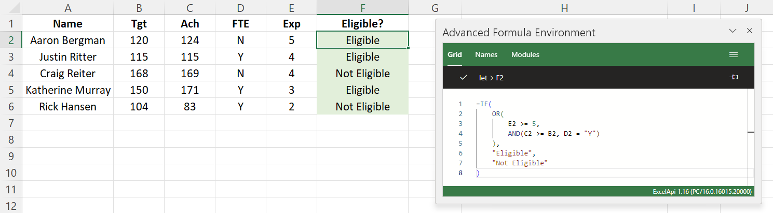
Use Advanced Formula Environment To Edit Complex Formulas
Insert > Formulas > Advanced Formula Environment
Check the formula
in an IDE interface!
Get advanced code options
like any code editor

Slide 35
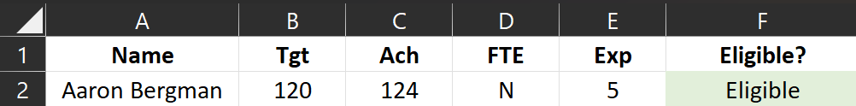
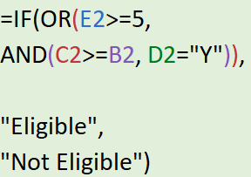
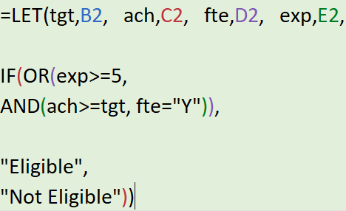
Make Formulas more readable using LET
DO Use LET to make formulas descriptive
DO NOT
Write Formulas
like this

Slide 36
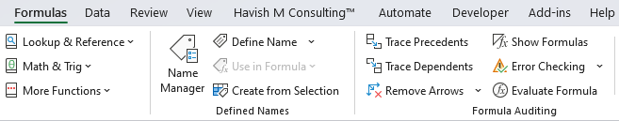
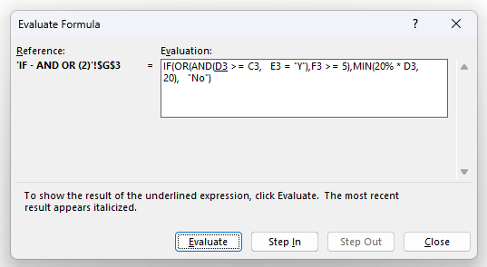
Evaluate formula step-by-step

Slide 37
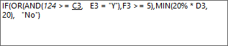
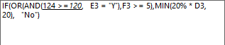
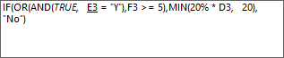
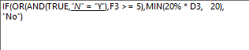
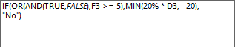
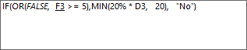








Evaluate formula step-by-step

Slide 38



Find Precedent / Dependent

Slide 39
Connect Excel and PowerPoint

Slide 40



Connect Excel And PowerPoint Dynamically
Step 1
Copy from Excel
Step 2
Home > Paste Special
Step 3
Paste Link > Microsoft Excel Worksheet Object

Slide 41

Connect Excel And Powerpoint Dynamically
They are linked!
Any change in Excel will now reflect in PowerPoint

Slide 42
Navigation

Slide 43

Hide / Unhide the Ribbon to
Increase Real Estate
Ctrl + Shift + F1
Toggles the ribbon – gives more real estate on the worksheet

Slide 44

Hide / Unhide the Ribbon to
Increase Real Estate
Ctrl + F1
Toggles the ribbon – keeps the Tabs visible

Slide 45



Move between Sheets
Ctrl + PgUp Ctrl + PgDown
Shift between sheets

Slide 46


See list of all Sheets

Slide 47




Jump to First / Last Row
Ctrl Up / Down
Jump to first / last Row

Slide 48




Jump to First / Last Column
Ctrl Left / Right
Jump to first / last
Column

Slide 49



Zoom In / Out
Pinch In / Out on touchpad
Zoom In / Zoom Out

Slide 50



Freeze Panes
View > Freeze Panes
All cells to the Left and Top are Frozen

Slide 51




Apply Sort
Data > Filter
Ctrl + Shift + L
or
Alt > A > T

Slide 52

Open Sort Dropdown
Alt + Down Arrow
Open Sort and Filter

Slide 53

Filter Options for Date
Options available:
Sort A > Z
Sort A < Z
Sort by Color
Filter by Color
Date Filters

Slide 54

Filter Options for Text
Options available:
Sort A > Z
Sort A < Z
Sort by Color
Filter by Color
Text Filters

Slide 55

Filter Options for Numbers
Options available:
Sort A > Z
Sort A < Z
Sort by Color
Filter by Color
Number Filters

Slide 56




Custom Sort

Slide 57
Custom Sort

Slide 58

Group Columns and Rows
Data > Group > Group
Can be applied on both Rows and Columns
Can also be applied at multiple levels

Slide 59


Subtotal
Data > Outline > Subtotal

Slide 60

Group Sheets
Group Sheets
Use Ctrl to select Specific sheets Use Shift to select sheets in continuation

Slide 61




Group Sheets
Changes happen on all sheets Formulas / Formatting etc.

Slide 62


Custom Format
Shortcut:
Ctrl + 1

Slide 63



Custom Format

Slide 64

Custom Format

Slide 65

Styles
Home > Styles > Cell Styles

Slide 66


Data Validation
Data > Data Validation

Slide 67






Data Validation

Slide 68


Data Validation

Slide 69

Data Validation
=AND(ISNUMBER(E11), VALUE(LEFT(E11,1)) = 9, LEN(E11) = 10)

Slide 70



Data Validation

Slide 71
Cell Referencing

Slide 72


Relative Reference

Slide 73


Absolute Reference
Press F4 to apply Dollar signs
G7
$G$7
G$7
$G7

Slide 74


Mixed Reference
TIP: Dollar sign only comes on First Column and First Row

Slide 75


Relative Reference - Dynamic

Slide 76


Absolute Reference - Dynamic

Slide 77


Mixed Reference

Slide 78
Data Prep Text to Columns

Slide 79

TEXT TO COLUMNS
“_” is the delimiter

Slide 80

TEXT TO COLUMNS
Data > Text to Columns

Slide 81

TEXT TO COLUMNS
Choose “_” as Other Delimiters

Slide 82

TEXT TO COLUMNS
Finish

Slide 83

TEXT TO COLUMNS
Final Output

Slide 84

TEXT TO COLUMNS
Can skip Columns Choose different destination

Slide 85

TEXT TO COLUMNS

Slide 86
Flash Fill

Slide 87



Use Flash Fill To Combine / Extract Data
Data > Data Tools > Flash Fill
Does NOT create a formula

Slide 88


Get First Word
sample

Slide 89


Changes Dynamic Temporarily
It remains dynamic temporarily –
once we move to a different cell the values become permanent

Slide 90


Take Sample From Any Row

Slide 91


Get Last Word
sample

Slide 92


Change Case

Slide 93


No Limit On Number Of Rows

Slide 94

Specific Rows
Can run on specific rows

Slide 95

Blank Column Not Allowed

Slide 96


Works On Left And Right

Slide 97


Combine Two Or More Columns

Slide 98


Merge - Add Characters

Slide 99


Change Position

Slide 100


Extract Numbers and Text
Excel does not have a native function for this

Slide 101


Extract Numbers and Text Non Uniform

Slide 102


Highly Inconsistent Data
Two samples are enough

Slide 103


Highly Inconsistent Data
BUT: More samples are not always better Choice of samples also matter!

Slide 104


Sample Selection for Ambiguous / Complex Problems
Does not work correctly
Picks the lower case “a”

Slide 105


Sample Selection for Ambiguous / Complex Problems
Works with different sample

Slide 106


No Column Choice
Choose C or F?
You cannot decide which columns to use as INPUT

Slide 107
Data Prep
Data Cleaning

Slide 108

Find Text

Slide 109

Find Text - Aaron

Slide 110

Find Text – Aaron Bergman

Slide 111

Find Text – Aaron Bergman (Match case)

Slide 112

Find Text – Aaron (Match entire cell contents)

Slide 113

Find Text – Aaron (Match case + Match entire cell contents)

Slide 114

Find Text – Aaron* (Any name starting with Aaron)

Slide 115

Additional Options – Also shows formulas

Slide 116



Additional Options – Search in Sheet and Workbook

Slide 117

Additional Options – Find and Replace Formats

Slide 118

Additional Options – Find and Replace Formats

Slide 119
Data Prep Functions

Slide 120





LEFT RIGHT MID

Slide 121

Irregular Length

Slide 122



Irregular Length

Slide 123



CONCATENATE
Is now legacy

Slide 124


CONCAT
Advantage
Choose range, or individual cells
Can keep different delimiters

Slide 125


TEXTJOIN
Advantage Keep same delimiter
Disadvantage
Cannot use different delimiters

Slide 126


TEXTJOIN
How to handle missing values TRUE keeps 1 underscore FALSE keeps multiple underscore

Slide 127



TRIM
Removes 3 types of spaces
Leading (before First word)
Extra between words Trailing (after Last word)

Slide 128



SUBSTITUTE

Slide 129



CHAR
CHAR 10 is line break

Slide 130




CHAR

Slide 131



REPLACE

Slide 132



REPT

Slide 133




EXACT

Slide 134

Replace Position

Slide 135





Replace Position

Slide 136


Start Character

Slide 137





Convert Data Type – VALUE and TEXT

Slide 138




ROUND, ROUNDUP, ROUNDDOWN

Slide 139


MROUND

Slide 140
Conditional Statements

Slide 141



IF

Slide 142



IF with AND

Slide 143





IF with Multiple Results

Slide 144


IF with AND OR

Slide 145


IF with AND OR with Limit

Slide 146


IF with AND OR with Limit using LET

Slide 147
Functions

Slide 148

ERRORS

Slide 149




COUNT

Slide 150


COUNT text values

Slide 151


COUNTIF

Slide 152



COUNTIFS

Slide 153


COUNTIFS

Slide 154





SUMIFS

Slide 155



COUNT ERROR

Slide 156







LARGE SMALL

Slide 157







OFFSET, TAKE

Slide 158




SUBTOTAL
Subtotal ignores rows that are removed from filter

Slide 159



SUBTOTAL
Subtotal with 109 ignores hidden rows also

Slide 160




AGGREGATE
Aggregate ignores Errors and/or Hidden Rows

Slide 161
VLOOKUP

Slide 162

VLOOKUP – Same Sheet
TIPS
Dollar sign is mandatory
As formula will be copied down
Writing FALSE is mandatory 0 is the same as FALSE

Slide 163



VLOOKUP – Same Sheet
TIPS
Better to select entire column This will eliminate need of dollar Also, can pick new rows added later

Slide 164


VLOOKUP – Approximate Match
Note
IF is a better alternative
Column must be sorted A > Z
Interval size can be non-equal

Slide 165


VLOOKUP – Array
Note
Comma (,) Breaks into column
Semi colon (;) Breaks into row

Slide 166



VLOOKUP – Handle Errors

Slide 167


VLOOKUP – Different Sheet

Slide 168



VLOOKUP – Different Sheet using Range Name
Formula is now simpler
Give Range Name
Select all Columns and give a Name

Slide 169

VLOOKUP – Different Sheet using Range Name
Formulas > Name Manager [Ctrl + F3]
Allows you to see a list of all named ranges in
one convenient place

Slide 170



VLOOKUP – Dynamic Column Number

Slide 171


VLOOKUP – Dynamic Column Number

Slide 172



VLOOKUP – Dynamic Column Number

Slide 173


VLOOKUP – Multiple Columns with Number Array
Can choose any columns in any order
{3,4}
{3,4,5}
{4,3}
{3,6}

Slide 174


VLOOKUP – Multiple Columns with MATCH

Slide 175


VLOOKUP – Multiple Columns with MATCH array

Slide 176



XLOOKUP

Slide 177

XLOOKUP with multiple columns
Note
Columns have to be in sequence

Slide 178




INDEX MATCH Look Left

Slide 179


INDEX MATCH Look Left Dynamic

Slide 180


VLOOKUP Look Left – using XLOOKUP

Slide 181


VLOOKUP with mismatched data types
Note
118 Text vs 118 Number
126 Text vs 126 Number

Slide 182



VLOOKUP with multiple column lookup

Slide 183

VLOOKUP with multiple workbooks
Windows and
Left arrow
will shift current Excel to left side of your screen

Slide 184

VLOOKUP with multiple workbooks
Now both Excel files can be seen together Much easier to write Formulas!

Slide 185




INDIRECT
‘
‘!

Slide 186


Filter Multiple Values – Old Method

Slide 187



Filter Multiple Values – New Method

Slide 188


Filter Multiple Values – Line Break

Slide 189


Filter Multiple Values – Top Values

Slide 190


Filter Multiple Values – with SUM

Slide 191
DATE FUNCTIONS

Slide 192

How Date Works

Slide 193

Date Formats

Slide 194

Extract Date Parts

Slide 195

Extract Date Parts
TEXT changes the value (it is NOT a date anymore)
Format only changes the appearance, not the value (it still remains a date)

Slide 196

How Time Works

Slide 197

Extract Time Parts

Slide 198

Date and Time together

Slide 199



Find Deadline as per Working Days
- 1 is required to make sure Start Date is included
Holiday list is optional

Slide 200


Find Difference in Working Days
Holiday list is optional

Slide 201



EDATE and EOMONTH

Slide 202



DATEDIF – Difference in Years, Months and Days

Slide 203


DATEDIF – Convert Days to Years, Months

Slide 204


Replace Position

Slide 205

Add Hours

Slide 206


Find Weekends

Slide 207



List of Dates

Slide 208



Convert Month Name to Number to Month Name

Slide 209
Pivot Tables

Slide 210

Create Pivot Tables
All columns should have headings

Slide 211

Create Pivot Tables
Data is selected automatically Make sure to double check correct range

Slide 212

Create Pivot Tables
DO NOT select entire column Otherwise blank rows will be picked up

Slide 213

Change Column Order
Can change Sort Order of Columns

Slide 214


Show Fields List
Make sure to click on any cell within the Pivot Table range to show the PivotTable Fields list
If you select a cell outside – the Fields list does NOT appear

Slide 215

Change Data Source
PivotTable Analyze > Change Data Source > Change Data Source

Slide 216

Replace Blank Cells

Slide 217

Replace Blank Cells

Slide 218

Items with no data are not shown by default

Slide 219


Items with no data are not shown by default
Field Settings > Layout & Print > Show Items with no data

Slide 220


Move PivotTable Fields Pane

Slide 221

Summarize

Slide 222

Refresh Pivot Table
Alt + F5

Slide 223

Clear All Filters

Slide 224


Change Label Names

Slide 225


Group Items

Slide 226


Show Details Behind a Value
Double click
to see values behind a cell

Slide 227


Option can be turned off

Slide 228

Two Fields can also be kept in “Values”
Note:
The “Values” in “Columns” comes automatically whenever 2 or more Fields are kept in “Values”

Slide 229


Dates can be Grouped

Slide 230

Shift Year and Month

Slide 231


Insert Slicer

Slide 232

Slicer is same as Filter

Slide 233

Choose Sheets the Slicer syncs with

Slide 234

Insert Blank Line after Each Item

Slide 235

Hide Items Faster

Slide 236
CONDITIONAL FORMATTING

Slide 237

Conditional Formatting
Home > Conditional Formatting

Slide 238

Highlight Cells

Slide 239


Highlight Cells
Can choose Custom Format

Slide 240

Highlight Cells
Can select a cell

Slide 241


Manage Rules

Slide 242

Clear Rules

Slide 243

Top / Bottom

Slide 244


Data Bars

Slide 245



Data Bars with Rules

Slide 246


Data Bars with Rules

Slide 247


Color Scales

Slide 248


Color Scales with Rules

Slide 249


Format cells that contain

Slide 250

Icon Sets

Slide 251


Icon Sets

Slide 252


Highlight Entire Row

Slide 253


Highlight Mobile Number

Slide 254
LAMBDA
Count error Weekend
Arraytotext
counttext

Slide 255


Follow me on YouTube
youtube.com/c/havishmadhvapaty

